Slide 1
Watersheds 101

Slide 2
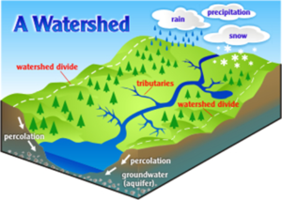
What is a watershed?
A watershed is an area of land that moves water from high points into lower points like lakes, streams, and rivers, and eventually into larger water bodies like oceans or large lakes.
In the water cycle, after precipitation falls, it collects in areas determined by the watershed; not all water goes to the same place

Slide 3
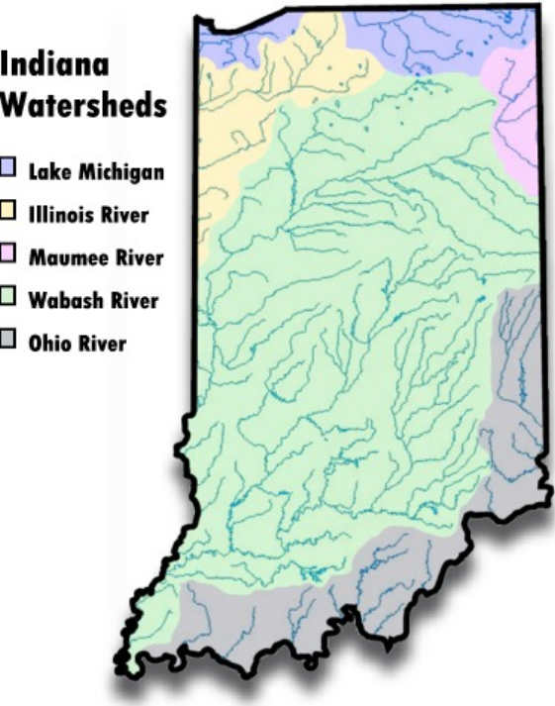
What’s my watershed?
Saint Joseph County is part of the St. Joseph Watershed, which is part of the larger Lake Michigan Watershed. It is also part of the Kankakee Watershed, which is part of the larger Illinois River Watershed.
The different map colors represent the different watersheds in Indiana

Slide 4
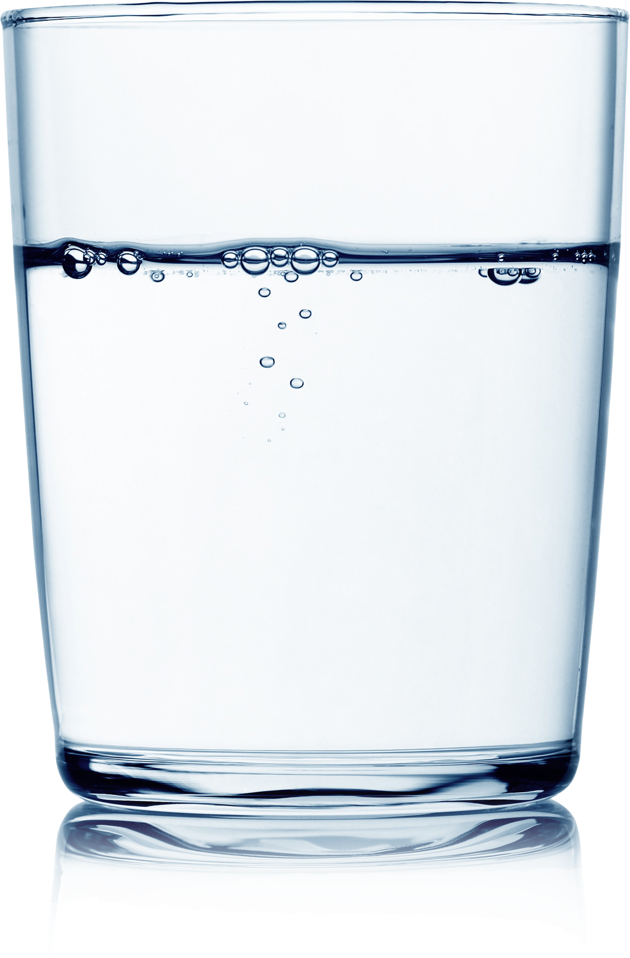
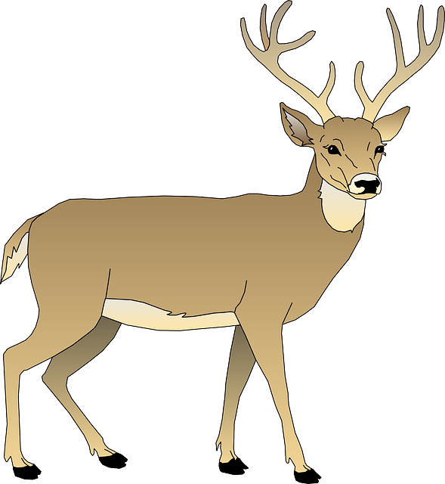
Why are watersheds important?
Watersheds support healthy habitat for plants and animals and provide drinking water for us and for wildlife. They are also good for recreation, like fishing, boating, and swimming!
This Photo by Unknown Author is licensed under CC BY-NC
This Photo by Unknown Author is licensed under CC BY

Slide 5
Why should we protect the watershed?
70% of Earth is water, but only 2.5% of that is freshwater, and only 1.2% of that water is available, and most of that water is frozen and difficult if not impossible to access.
There isn’t much freshwater available for our use, so the freshwater going through the water cycle and into the watershed must be as clean as possible so that we can have safe, potable water to use.

Slide 6
How can you help?
There are many easy things we can do to care for the watershed:
Conserve household water use
Take shorter showers, fix pipe leaks, wash full loads of laundry
Reduce fertilizer use
Use permeable surfaces (wood, gravel, brick) for decks, driveways, and walkways
Never pour chemicals down the drain
Clean up after your pets
Drive less
Carpool, take public transit, bike, or walk when possible
Recycle and compost household waste
Use hardy, native plants that require less watering
Properly dispose of medications and other hazardous wastes
This Photo by Unknown Author is licensed under CC BY-ND
This Photo by Unknown Author is licensed under CC BY-SA
This Photo by Unknown Author is licensed under CC BY

Slide 7
More resources
Contact us
St. Joseph County Soil and Water Conservation District
2903 Gary Dr.
Plymouth, IN 46563
(574) 936-2024 ext. 4

