Slide 1
The Rock Cycle

Slide 2
What is the rock cycle?
The rock cycle is the process by which all rocks (igneous, sedimentary, and metamorphic) are formed, broken down, and reformed as a result of chemical and/or physical processes
We can use the rock cycle to better understand the geological history of an area

Slide 3
Types of rocks
To understand the rock cycle, we must understand the 3 types of rocks:
Igneous
Sedimentary
Metamorphic
Each type is created in a different way through the rock cycle

Slide 4
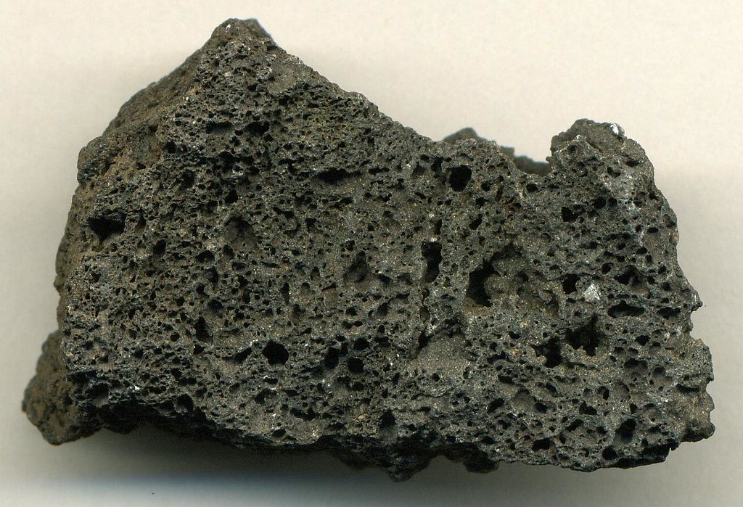
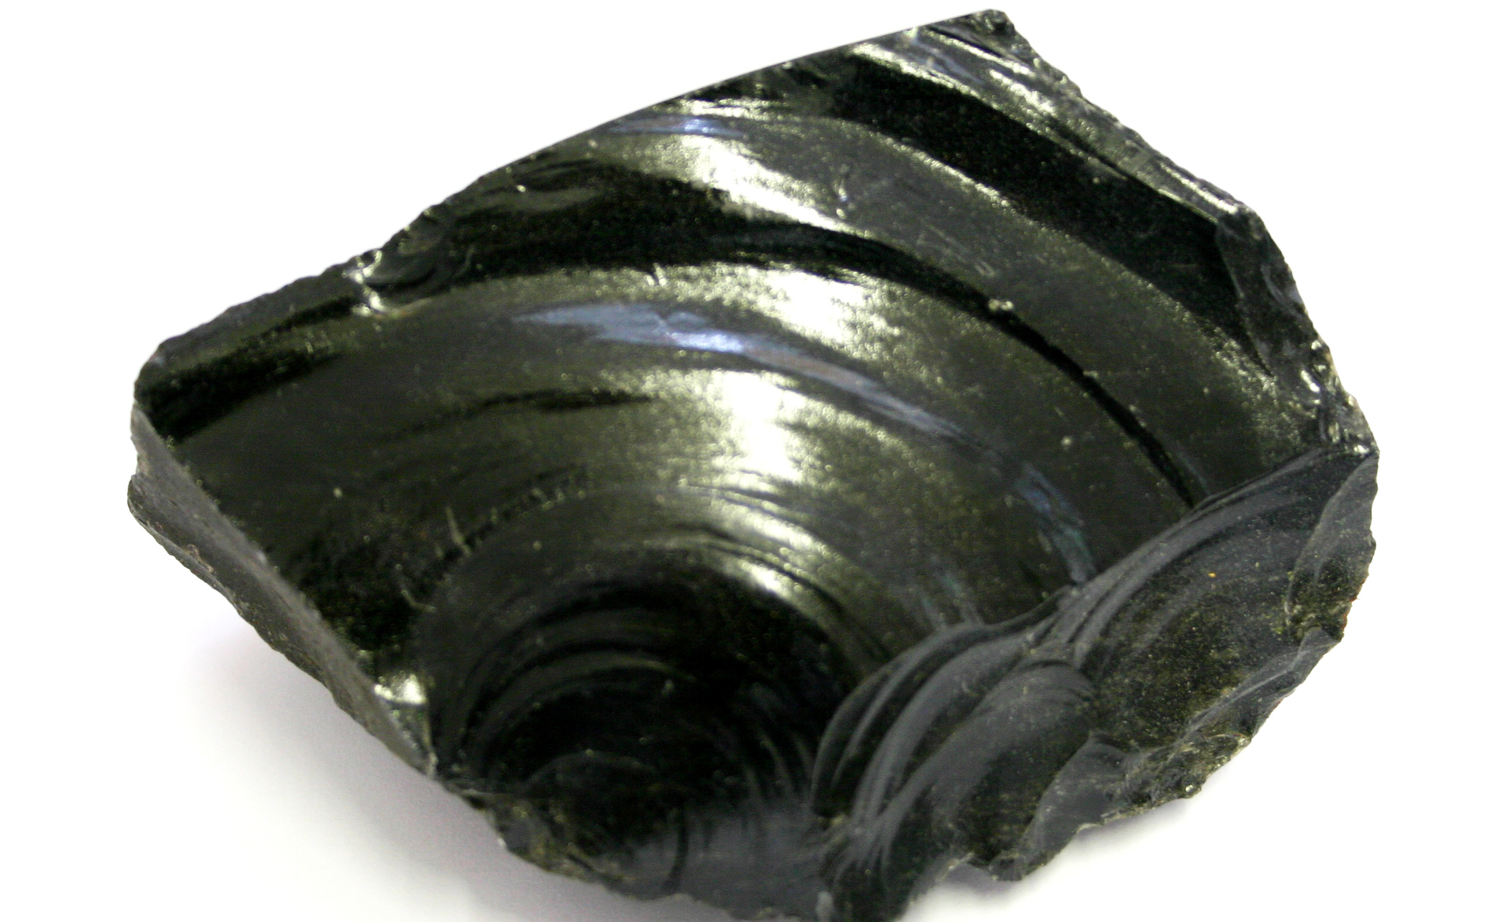
Igneous rocks
Igneous
Formed from cooled, crystalized magma
Intrusive
Magma that cools under the earth’s surface
Extrusive
Magma that escapes and cools on top of the earth’s surface
This Photo by Unknown Author is licensed under CC BY
This Photo by Unknown Author is licensed under CC BY

Slide 5
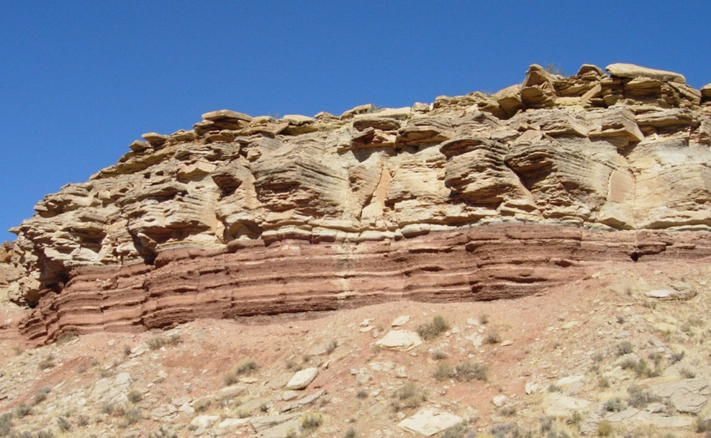
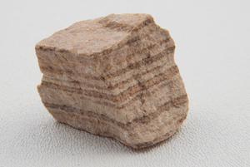
Sedimentary rocks
Sedimentary
Formed when pressure forces sediments together
Often contain fossils
Visible layers
This Photo by Unknown Author is licensed under CC BY-SA
This Photo by Unknown Author is licensed under CC BY-SA

Slide 6
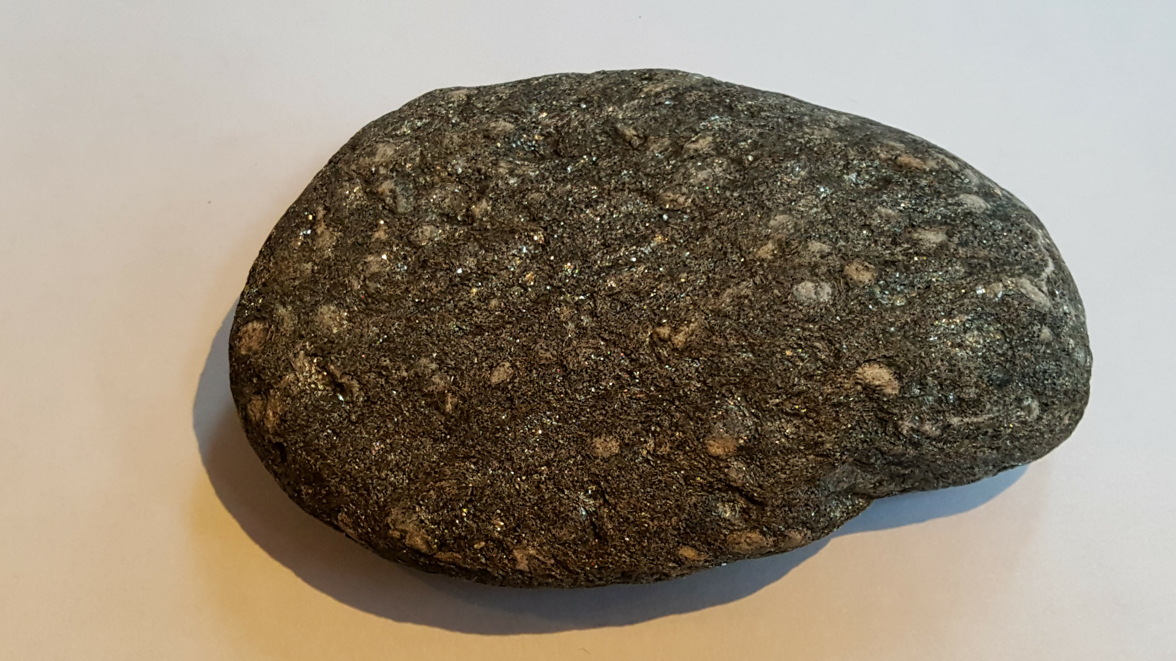
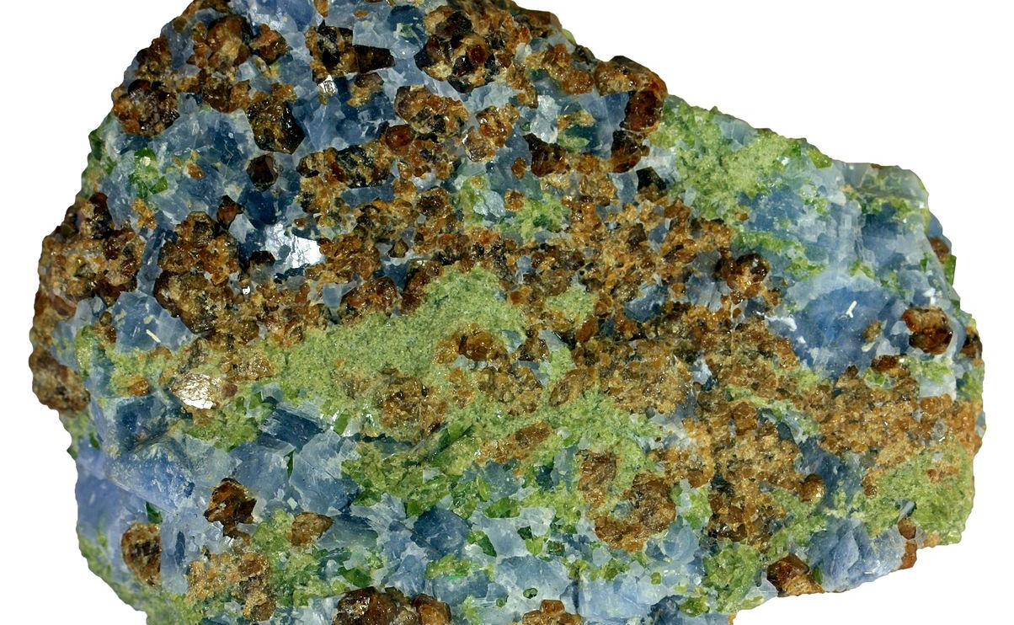
Metamorphic rocks
Metamorphic
formed from existing rocks that are subjected to heat and pressure
This Photo by Unknown Author is licensed under CC BY-NC-ND
This Photo by Unknown Author is licensed under CC BY

Slide 7
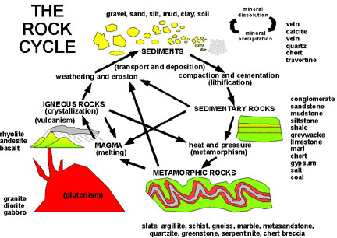
The rock cycle starts with magma (molten rock under Earth’s surface) which then cools and crystalizes to become igneous rock.

Slide 8
Through the different physical and chemical properties shown on the right, igneous rock becomes sedimentary and metamorphic rock, which can then be further broken down and changed into the different rock types
Sedimentary and metamorphic rocks can only become igneous rocks after they have been completely melted down back into magma

