Slide 1

Stormwater

Slide 2

What is stormwater?
When rain falls on impervious surfaces (surfaces that can’t absorb water, like pavement and rooftops) and flows over the land, it becomes stormwater runoff
Stormwater flows into stormwater drains, ditches, canals, lakes, wetlands, rivers, and coastal waters
Stormwater can become polluted, which can further pollute the water we use for drinking, cooking, and recreation

Slide 3
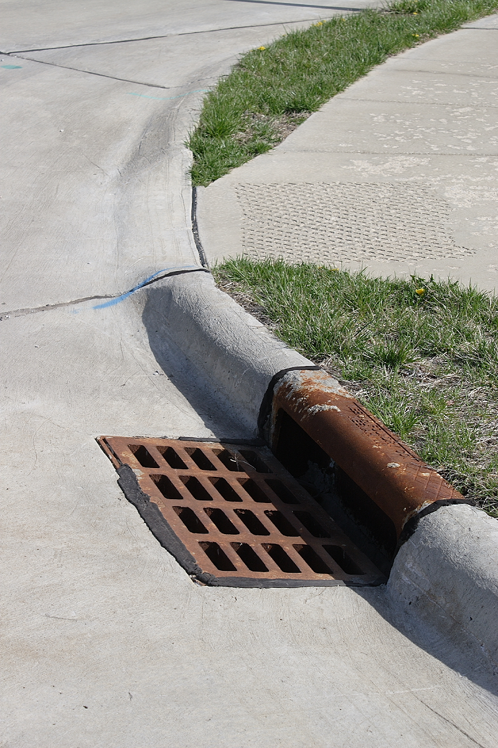
How does a storm drain work?
Storm drains carry all stormwater into rivers and streams
They are not connected to the wastewater system (the system that drains water from plumbing systems)
They do not go to water treatment facilities, so any kind of pollution in the stormwater goes directly into our rivers and streams
This Photo by Unknown Author is licensed under CC BY-SA

Slide 4

How does stormwater pollution happen?
As stormwater runoff flows over the land, it picks things up along the way, including:
  Trash
  Pet waste
  Yard waste (like leaves and twigs)
  Chemicals (like fertilizers)
  Sediment
In Michiana, our stormwater is not treated before it enters our rivers and streams, so stormwater pollution can be easily transferred to our water bodies

Slide 5
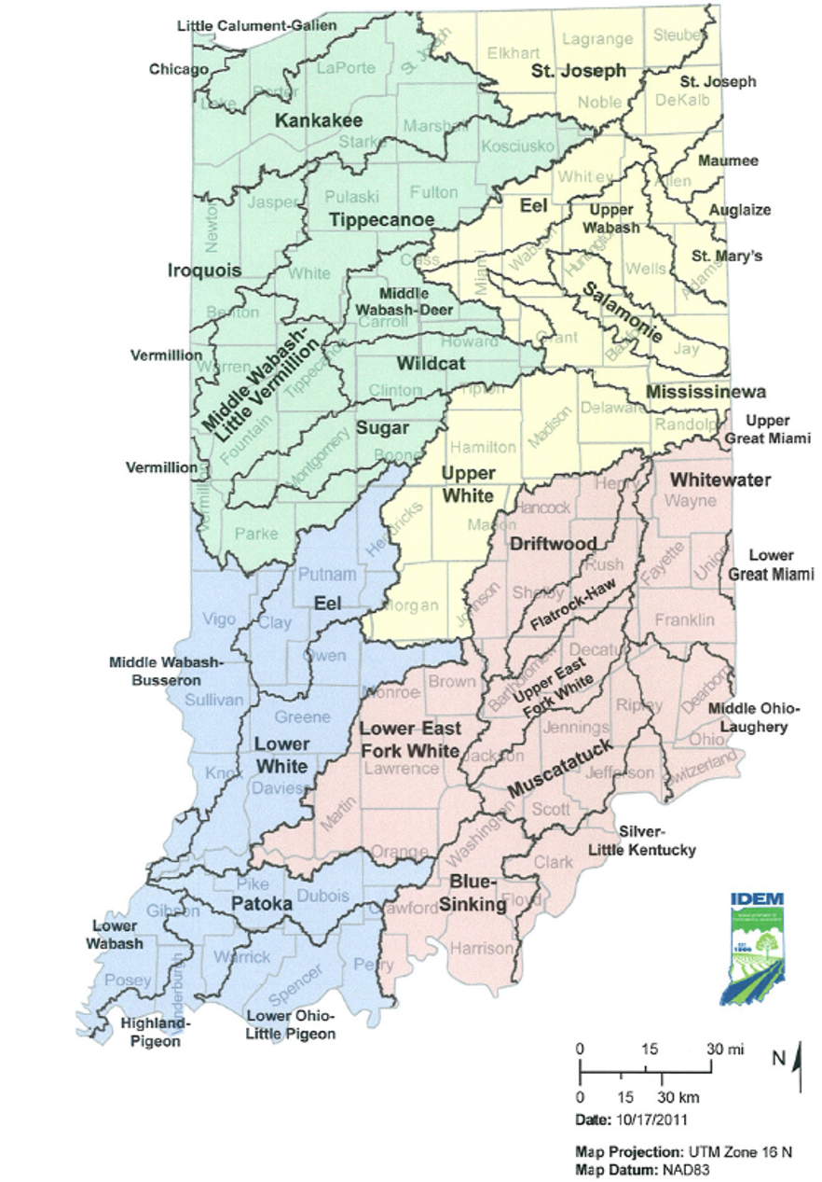
Where does stormwater go?
Stormwater runoff drains into our watershed, which then leads onto larger bodies of water
  A watershed is an area of land that drains into a larger body of water
  Polluted stormwater can further pollute the watershed
St. Joseph County is part of the St. Joseph watershed which leads into Lake Michigan, as well as the Kankakee watershed which leads into the Illinois River

Slide 6
How can we prevent stormwater pollution?
There are plenty of easy ways to help keep stormwater clean!
  Get rid of trash and recycling properly
  Properly dispose of pet waste. Make sure it gets into the trash can!
  Wash your car in a car wash or in your yard (instead of on top of concrete)
  Never dump anything down storm drains
  Compost yard waste
  Use fertilizers sparingly
  Consider using rain barrels or installing rain gardens

Slide 7
More information
Michiana Stormwater Partnership
St. Joseph County Soil and Water Conservation District
  2903 Gary Dr.
  Plymouth, IN 46563
  (574) 936-2024

